Slide 1

Advanced topics in Hardware Security
-
Microarchitectural Side-Channel Attacks
Luca Cassano
luca.cassano@polimi.it
cassano.faculty.polimi.it/HW_sec.html

Slide 2
Acknowledgment
Prof. Mark Tehranipoor
University of Florida (US)
Prof. Marco Ottavi* and Marco Spaziani Brunella
University of Rome Tor Vergata (IT)
*also with University of Twente (NL)

Slide 3
Side-Channel Attacks

Slide 4
Side-Channel Attacks
A super simple example:
You have a red pot and a blue pot
You put $28 in one of the pots and $10 in the other:

Slide 5
Side-Channel Attacks
A super simple example:
You have a red pot and a blue pot
You put $28 in one of the pots and $10 in the other:
I ask you to:
  multiply by mental calculation the content of the blue pot by 10
  multiply by mental calculation the content of the red pot by 7
  add the two results
  tell me if the sum is odd or even

Slide 6
Side-Channel Attacks
A super simple example:
You have a red pot and a blue pot
You put $28 in one of the pots and $10 in the other:
I ask you to:
  multiply by mental calculation the content of the blue pot by 10
  multiply by mental calculation the content of the red pot by 7
  add the two results
  tell me if the sum is odd or even
Is your answer enough to reveal what’s in each pot?

Slide 7
Side-Channel Attacks
A super simple example:
28 × 7 + 10 × 10 = 296 is an even number
and
10 × 7 + 28 × 10 = 350 is also even
But…

Slide 8
Side-Channel Attacks
A super simple example:
28 × 7 + 10 × 10 = 296 is an even number
and
10 × 7 + 28 × 10 = 350 is also even…
But…just by monitoring the time it takes to give the answer (the mental calculation leading to 296 is more complicated than the one leading to 350) one can tell where each amount is!

Slide 9
Side-Channel Attacks
A super simple example:
The external monitoring of the processing time of a card may leak secrets to the external world (e.g. credit keys, PINs etc).
Timing attacks were exposed in the early 1990’s.
Lesson learned: Current card software runs in constant time

Slide 10
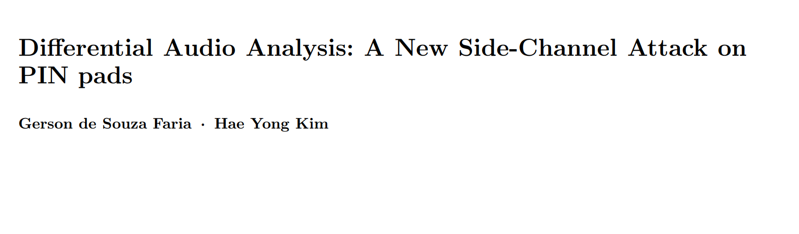
Side-Channel Attacks

Slide 11
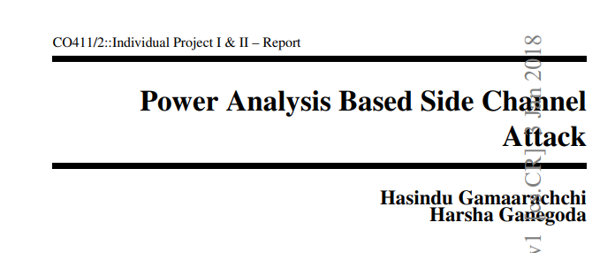
Side-Channel Attacks

Slide 12
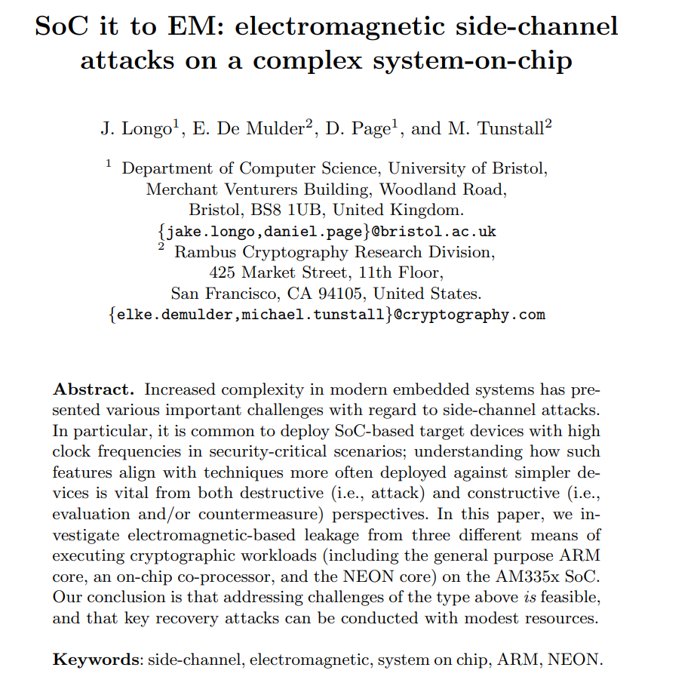
Side-Channel Attacks

Slide 13
Side-Channel Attacks
Side-Channel attacks look at side-channel inputs and outputs, bypassing the theoretical strength of cryptographic algorithms → use additional information to break the cryptographic protection
Five commonly exploited side-channel emissions:
Power Consumption
Electro-Magnetic
Optical
Timing and Delay
Acoustic

Slide 14
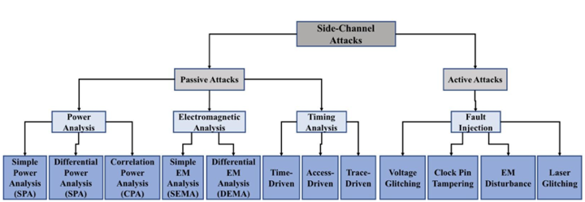
Side-Channel Attacks
Passive attacks: observe the behavior of the device to infer information about the secret
Active Attacks: physically operate on the device to gather information about secret (e.g. fault injection or microprobing)

Slide 15

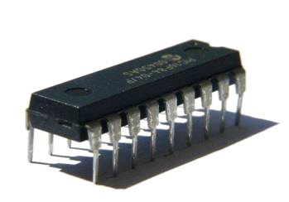

Side-Channel Attacks
Physical attacks ≠ Cryptanalysis
(gray box, physics) (black box, maths)
Does not tackle the algorithm's math
Observe physical quantities in the device's vicinity and use additional information during cryptanalysis
Input
Output
Leakage

Slide 16
Side-Channel Attacks
Attack phases
  Interaction phase: interact with the hardware system under attack and obtain the physical characteristics of the device
  Analysis phase: analyze the gathered information to recover the key

Slide 17
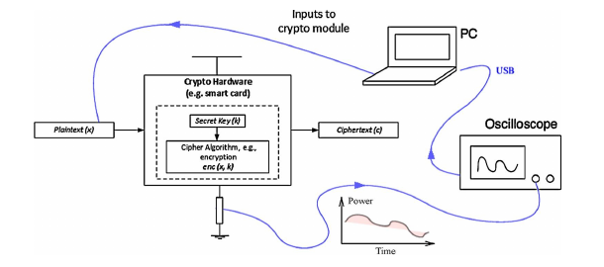
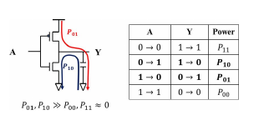
Side-Channel Attacks – Power Analysis
Dynamic power signals are directly related to the functional behavior of the device
Power signals are captured by measuring the change in current levels in the voltage supply transmission lines
An oscilloscope measures the voltage drop across a precision sense resistor connected between the power rail and Vdd or Gnd pin of the target device.

Slide 18
Side-Channel Attacks – Simple Power Analysis
Originally proposed by Paul Kocher, 1996
SPA is a technique that aims to observe power measurements obtained while the device under attack is in operation mode.
  This type of analysis does not require any advanced or statistical processing stages.
SPA attacks are applied to devices with limited accessibility,
  one or few power traces are available.
  The attacker attempts to observe critical information or secret keys from that trace.
  Multiple power traces are averaged to remove noise.

Slide 19
Side-Channel Attacks – Simple Power Analysis
Visual inspection of power traces is considered the primary form of SPA attack
  A power trace shows a sequence of patterns to identifying key bits, instructions, or functions.
  Each instruction in a processor could be visually identified in the power trace.
Also Machine Learning Approaches are being applied

Slide 20
Side-Channel Attacks – Simple Power Analysis
Attacking RSA
Basics of RSA:
m is the plaintext and c is the cyphertext
n = p * q public modulus, with p and q two large prime numbers (0 <= m <= n)
e public exponent (calculated based on p and q)
d private exponent (calculated based on p and q)
e, d and n are such that
  (m^{e})^{d} = m mod n
  (m^{d})^{e} = m mod n
The public key is (n, e)
The private key is (n, d)

Slide 21
Side-Channel Attacks – Simple Power Analysis
Attacking RSA
Basics of RSA:
when encrypting c = m^{e} mod n
Such encryption can be inverted (decrypted) only knowing the d associated with e
when decrypting m = c^{d} mod n

Slide 22
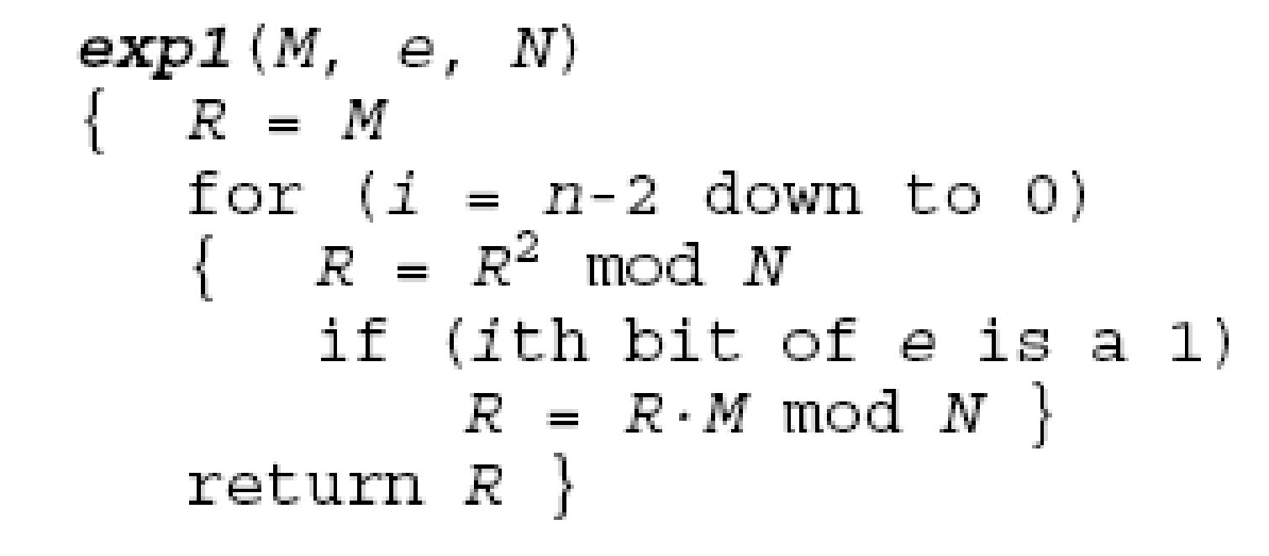
Side-Channel Attacks – Simple Power Analysis
Attacking RSA
The exponent calculation can be efficiently implemented through the square&multiply algorithm
R = Me mod N can be calculated as:
square and multiply algorithm

Slide 23
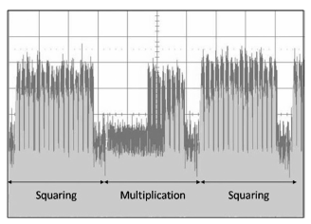
Side-Channel Attacks – Simple Power Analysis
Attacking RSA
The exponent calculation can be efficiently implemented through the square&multiply algorithm
R = Me mod N can be calculated as:
square and multiply algorithm

Slide 24
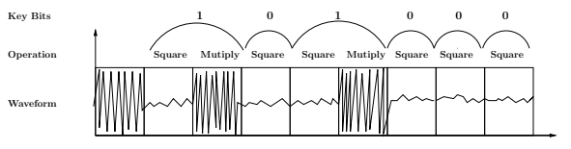
Side-Channel Attacks – Simple Power Analysis
Attacking RSA
The exponent calculation can be efficiently implemented through the square&multiply algorithm
R = Me mod N can be calculated as:
square and multiply algorithm

Slide 25
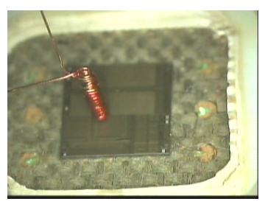
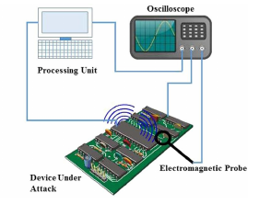
Side-Channel Attacks – EM Emissions Analysis
Setup based on the correlation between the EM emission detected and the internal activity

Slide 26
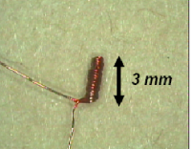
Side-Channel Attacks – EM Emissions Analysis
EM radiation is correlated to the switching activities of CMOS gate circuits.
Inductive probes are used to capture the EM radiation caused by switching activities of CMOS gate circuits inside the chips.
The probe itself should be small enough to enable accurate location.

Slide 27
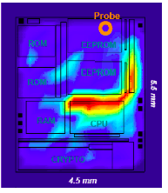
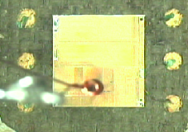
Side-Channel Attacks – EM Emissions Analysis
Horizontal cartography (XY plane)
  to pinpoint instruction related areas
  better if automated
Provides more information than power analysis

Slide 28
Side-Channel Attacks – EM Emissions Analysis
Advantage of EMA versus PA
  Data correlation (like power analysis)
  Local information
  EMA bypasses current smoothers
  EMA goes through HW countermeasures: shields, randomized logic
Drawbacks
  Experimentally more complicated
  Low level and noisy signals (decapsulation required)

Slide 29
Microarchitectural Side-Channel Attacks

Slide 30
Microarchitectural Side-Channel Attacks
Side-Channel Attacks that leak secret information without even needing physical access to the attacked system…
…pure software execution!!!

Slide 31



Microarchitectural Side-Channel Attacks
2018: the year of the disaster
January
August
November
More and more versions
of Spectre and Meltdown
Spectre
Meltdown
Foreshadow
Lipp, Moritz, et al. "Meltdown: Reading kernel memory from user space." Communications of the ACM 63.6 (2020): 46-56.
Kocher, Paul, et al. "Spectre attacks: Exploiting speculative execution." Communications of the ACM 63.7 (2020): 93-101.
Van Bulck, Jo, et al. "Foreshadow: Extracting the keys to the Intel SGX kingdom with transient out-of-order execution." Proceedings fo the 27th USENIX Security Symposium. USENIX Association, 2018.

Slide 32


Microarchitectural Side-Channel Attacks
The story continues
2019
2020
2022
Retbleed
Zombieload
Load Value Injection
Schwarz, Michael, et al. "ZombieLoad: Cross-privilege-boundary data sampling." Proceedings of the 2019 ACM SIGSAC Conference on Computer and Communications Security. 2019.
Van Bulck, Jo, et al. "LVI: Hijacking transient execution through microarchitectural load value injection." 2020 IEEE Symposium on Security and Privacy (SP). IEEE, 2020.
https://www.theregister.com/2022/07/12/amd_intel_retbleed/

Slide 33





















Microarchitectural Side-Channel Attacks
MSCAs are already considered a serious threat both at the academic and industrial level
Several IT companies published official security advisories about MSCAs*
*meltdownattack.com

Slide 34
Where do MSCAs come from: modern CPU features

Slide 35
Microarchitectural Side-Channel Attacks
All comes from transient instructions executions: instructions that are executed by the CPU although they shouldn’t have been…
…results are not committed to the main memory, the state of the CPU registers is recovered, but…
…the cache may contain the results of the trasient executions!!!
Let see where this comes from…

Slide 36
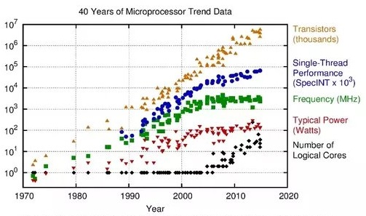
Modern CPUs features

Slide 37
Modern CPUs features
Cache memories and cache hierarchies
Pipelined execution
Speculative execution
Out-of-Order execution

Slide 38
Cache memories
Memory has always been a trade-off between storage capacity, cost and speed
Some memories have to be large enough to store the entire program code and data, but…
…other memories should be fast, although being small, to increase performance

Slide 39
Cache memories
Temporal locality: if a memory location is referenced, it will tend to be referenced again (for examples counters)
Spatial locality: if a memory location is referenced, also the neighbor location will tend to be referenced soon (for examples arrays)

Slide 40
Cache memories
Basic idea: put everything you need frequently (and what you suppose to need frequently) inside small, expensive and fast memories, while put the rest into slow, cheap and huge memories
Memory heterogeneity
Memory hierarchy

Slide 41
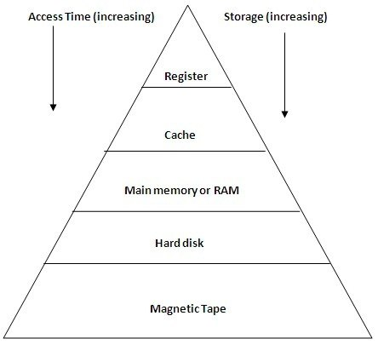
Cache memories

Slide 42
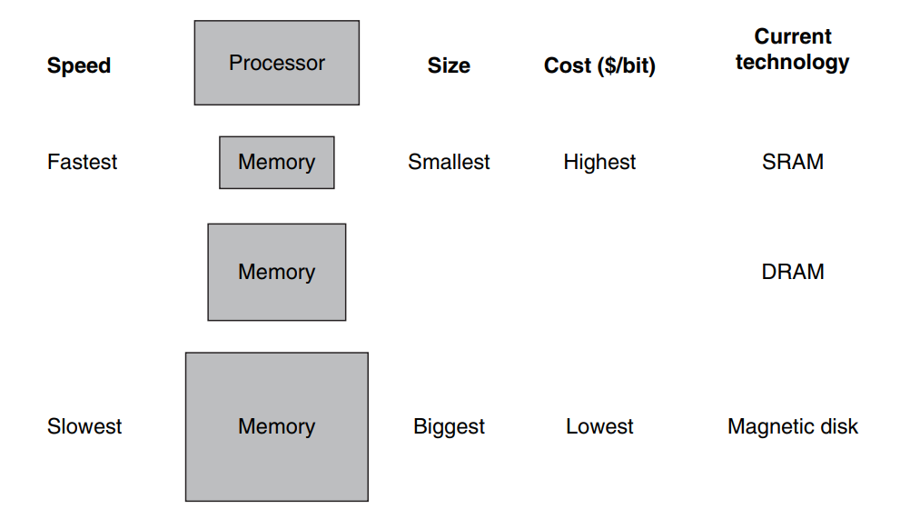
Cache memories

Slide 43
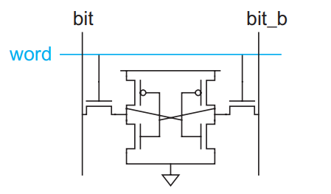
Cache memories
~10 ns
Few MB
6 transistors

Slide 44
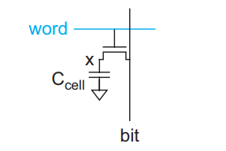
Cache memories
~10 ns
Few MB
6 transistors
~60 ns
Tenth of GB
1 transistor + 1 cap
(need refreshing circuitry)

Slide 45
Pipelined Execution
14 stage of pipeline inside a I7-920
Instruction memory
Instruction Fetch
Instruction Decode
Instruction Execute
Register File
Instr #3
Instr #2
Instr #1
Data
memory
Program
counter

Slide 46
Speculative Execution
But what if a conditional instruction enters the pipeline?
Shall other instructions enter the pipeline before the conditional instruction is executed?

Slide 47
Speculative Execution
But what if a conditional instruction enters the pipeline?
Shall other instructions enter the pipeline before the conditional instruction is executed?
Stall the pipeline: do not put anything in IF and ID and wait the IE to determine what the next instruction to be fetched should be…poor performances

Slide 48
Speculative Execution
But what if a conditional instruction enters the pipeline?
Shall other instructions enter the pipeline before the conditional instruction is executed?
Stall the pipeline: do not put anything in IF and ID and wait the IE to determine what the next instruction to be fetched should be…poor performances
Naif policy: assume that the branch will always be taken or not taken (50% percent probability of being wrong, resulting in a pipeline flush and start all over…big misprediction penalty)

Slide 49
Speculative Execution
But what if a conditional instruction enters the pipeline?
Shall other instructions enter the pipeline before the conditional instruction is executed?
Stall the pipeline: do not put anything in IF and ID and wait the IE to determine what the next instruction to be fetched should be…poor performances
Naif policy: assume that the branch will always be taken or not taken (50% percent probability of being wrong, resulting in a pipeline flush and start all over…big misprediction penalty)
Branch prediction: use HW blocks to “learn” from code which branches are most likely to be taken in order to increase the rate of correct predictions

Slide 50
Speculative Execution
But what if a conditional instruction enters the pipeline?
Shall other instructions enter the pipeline before the conditional instruction is executed?
Stall the pipeline: do not put anything in IF and ID and wait the IE to determine what the next instruction to be fetched should be…poor performances
Naif policy: assume that the branch will always be taken or not taken (50% percent probability of being wrong, resulting in a pipeline flush and start all over…big misprediction penalty)
Branch prediction: use HW blocks to “learn” from code which branches are most likely to be taken in order to increase the rate of correct predictions
Speculative execution may cause
trasient instructions execution!!!

Slide 51
Out-of-Order Execution
If an instruction b is waiting the results of a previous instruction a, the CPU makes b wait

Slide 52
Out-of-Order Execution
If an instruction b is waiting the results of a previous instruction a, the CPU makes b wait
Increasing the complexity of the architecture, we can:
  Fetch the instructions in-order (one by one) as they are stored in the instruction memory
  Try to execute them in-order. If there is any blocking instruction, execute the following non dependent instructions (out-of-order) and save the results somewhere (don’t push to registers)
  When the blocking instruction finally is executed, commit all the results in-order, in one clock cycle, to the registers

Slide 53
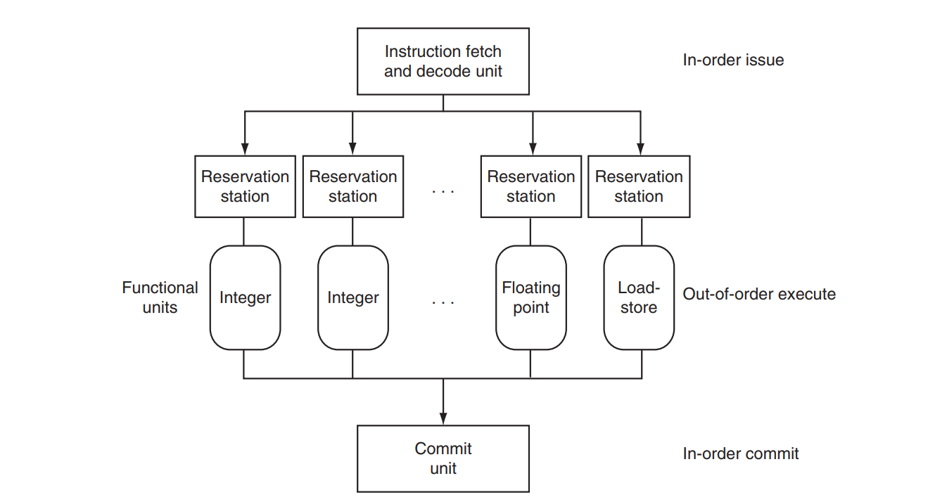
Out-of-Order Execution
Also Out-of-Order execution may cause
trasient instructions execution!!!
#4
#3
#2
#1
#2 depends on the results of #1: #2 waits in the reservation station
#1 finishes
Results are then committed in order to the registers and/or memory

Slide 54
Meltdown and Spectre

Slide 55
Meltdown and Spectre
char instrument[256]; // forced not to be in the cache
char x[10];
int address = 1000; // target address in the cache
char secret;
secret = instrument[x[address]];
// secret does not contain the "secret value" because an
// exception has been raised but...instrument[x[address]] is now // in the cache
for(int i = 0; i < 255; ++i) {
secret = instrument[i];
}
// only when i == x[address] the read operation will be fast
//(because of a cache hit) therefore the secret value is i

Slide 56
Meltdown and Spectre
Main Memory
Cache Memory
char instrument[256];
char x[10];
instrument
target data
x
target data

Slide 57
Meltdown and Spectre
Main Memory
Cache Memory
char instrument[256];
char x[10];
secret = instrument[x[address]];
instrument
target data
x
target data
target data

Slide 58
Meltdown and Spectre
Main Memory
Cache Memory
char instrument[256];
char x[10];
secret = instrument[x[address]];
instrument
target data
x
target data
target data

Slide 59
Meltdown and Spectre
Main Memory
Cache Memory
char instrument[256];
char x[10];
secret = instrument[x[address]];
instrument
target data
x
for(int i = 0; i < 255; ++i) {
secret = instrument[i];
}
target data
target data

Slide 60
Meltdown and Spectre
char instrument[256]; // forced not to be in the cache
char x[10];
int legal_address = <BETWEEN 0 AND 9>; // target address
int target_address = 1000; // target address
char secret;
// speculative execution poisoning
for(<A LOT OF TIMES>)
if(legal_address < 10)
secret = instrument[x[legal_address]];
if(target_address < 10)
secret = instrument[x[target_address]];
// secret does not contain the "secret value" because an exception has
// been raised but...instrument[x[address]] is now in the cache
for(int i = 0; i < 255; ++i) {
secret = instrument[i];
}
// only when i == x[address] the read operation will be fast
//(because of a cache hit) therefore the secret value is i

Slide 61
Countermeasures

Slide 62
MSCAs: Countermeasures
Existing solutions rely on:
  CPU architecture modifications to make execution time constant
      Applied during CPU design (not applicable on existing models)
      Platform-dependent
      Reduced performance
  Operating system intervention (deny cache sharing, periodically cache flush, add delays in program execution)
      Reduced performance

Slide 63
MSCAs: Countermeasures
Existing solutions rely on:
  Program’s control-flow manipulation at compile-time
      Reduced performance
  Machine Learning applied at the server- or at the data center-level
      Limited applicability due to high resource requirements

Slide 64
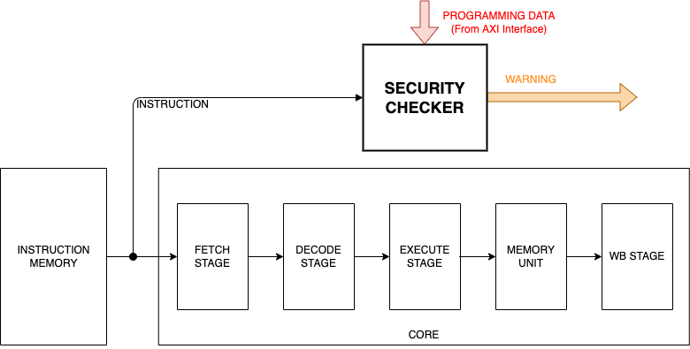
MSCAs: Countermeasures @ POLIMI
Solution
Observe and analyse the fetching activity of the CPU to identify anomalous working conditions
Processor Security: Detecting Microarchitectural Attacks via Count-Min Sketches, Kerem Arıkan et al., In IEEE Transactions on Very Large Scale Integration Systems, vol. 30, no. 7, pp. 938-951, July 2022

Slide 65
MSCAs: Countermeasures @ POLIMI
Solution
Teach to the system the signatures of the attacks and the expected occurrence frequencies
The Probabilistic Data Structures called Count-min Sketches (CMSs) have been used for this purpose
Processor Security: Detecting Microarchitectural Attacks via Count-Min Sketches, Kerem Arıkan et al., In IEEE Transactions on Very Large Scale Integration Systems, vol. 30, no. 7, pp. 938-951, July 2022

Slide 66
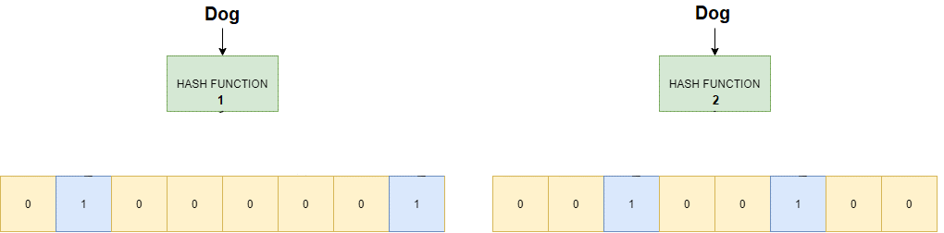
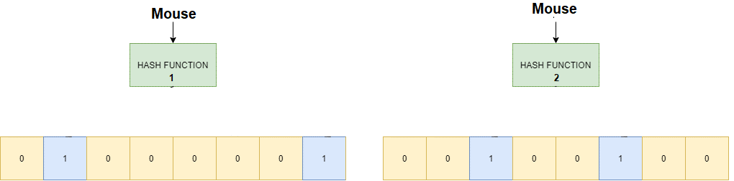
MSCAs: Countermeasures @ POLIMI
Count-Min Sketches
Like Bloom filters (see previous slides) but instead of estimating the presence/absence of an element into a set, CMSs estimate the occurrence frequence
Counter 1
Counter 2
Counter 1
Counter 2

Slide 67
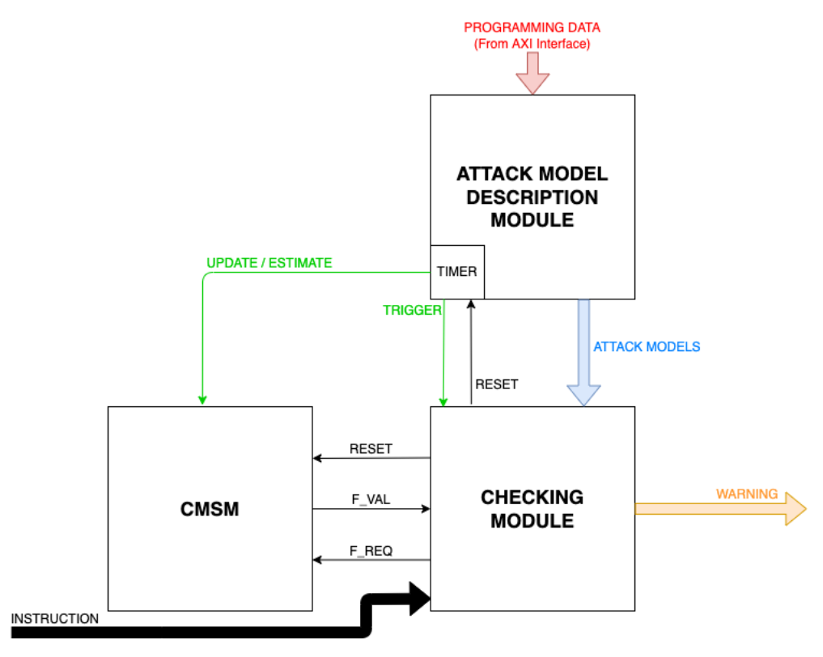
MSCAs: Countermeasures @ POLIMI
Solution
The Attack Model Description module (AMDM) takes descriptions of the attacks of interest
An attack description is:
A pattern of fetched instructions
The frequency values of the fetching of each instruction in the pattern after which the pattern becomes suspicious

Slide 68
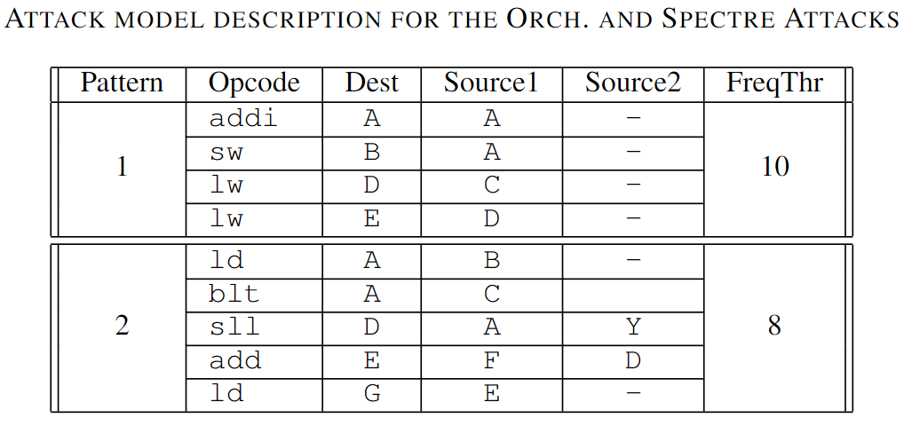
MSCAs: Countermeasures @ POLIMI
Solution
The Attack Model Description module (AMDM) takes descriptions of the attacks of interest
An attack description is:
A pattern of fetched instructions
The frequency values of the fetching of each instruction in the pattern after which the pattern becomes suspicious

Slide 69
MSCAs: Countermeasures @ POLIMI
Solution
The Count-min Sketch Module (CMSM) monitors the fetching frequency of each instruction
The Checking Module (CM) keeps track of the fetched patterns and compares them with the ones configured in the AMDM
When a suspicious pattern is recognized the occurrence frequency is checked (and eventually an alarm is raised)

Slide 70
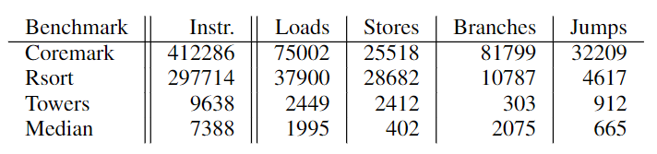
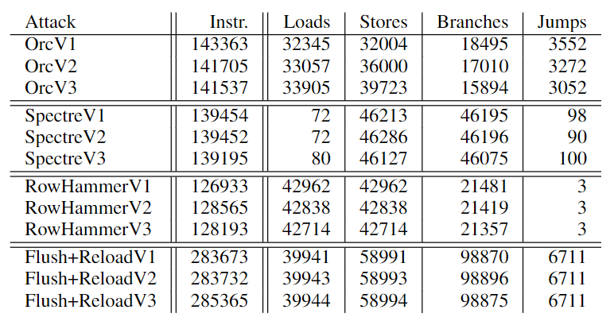
MSCAs: Countermeasures @ POLIMI
We implemented the checker and we integrated it into a RSD RISC-V core
We analysed several configurations of the checker (growing its size)
We got 0% false negatives (all attacks are detected)

Slide 71
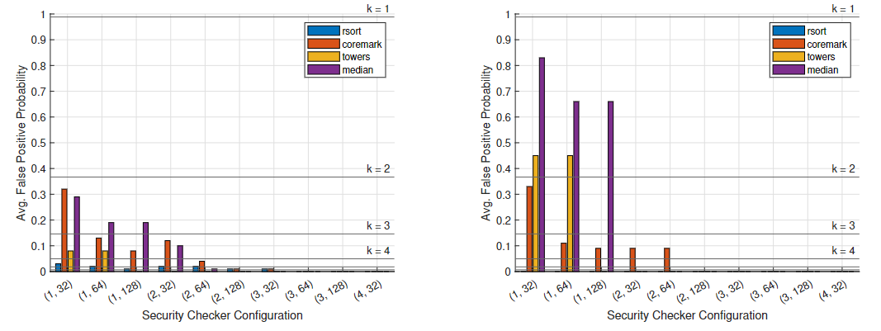
MSCAs: Countermeasures @ POLIMI
Based on the checker configuration we have a worst-case percentage of false positives (cases where no attack is active but a false alarm is raised)
Orchestration attack
SPECTRE attack

Slide 72
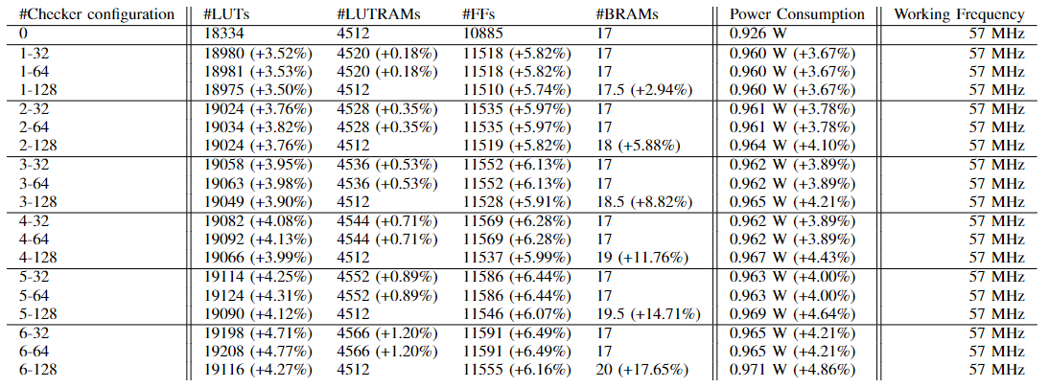
MSCAs: Countermeasures @ POLIMI
We got reduced area and power overhead and no working frequency reduction

Slide 73
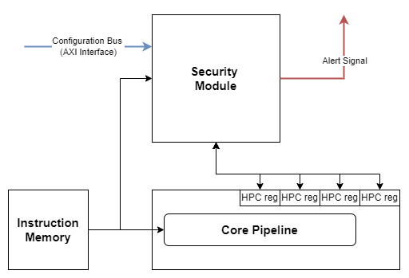
MSCAs: Countermeasures @ POLIMI
A similar solution has been implemented based on Machine Learning instead of Count-Min Skectes
Teach to the system the nominal behavior of the program (instead of the signatures of the attacks) by observing:
Fetching activity
HW performance counters

Slide 74
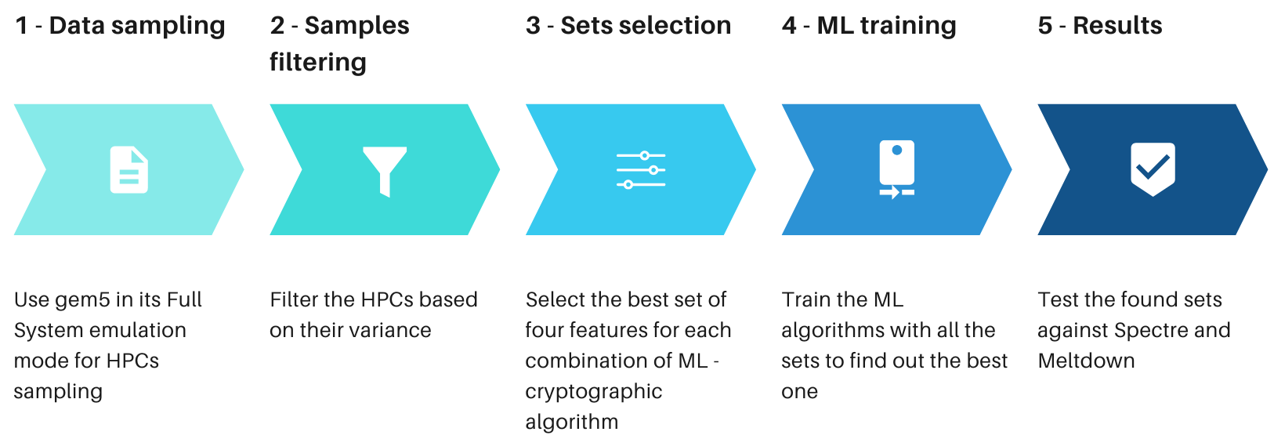
MSCAs: Countermeasures @ POLIMI

Slide 75
MSCAs: Countermeasures @ POLIMI
Considered attacks:
Spectre
Meltdown
Cryptographical algorithms under attack:
RSA
Idea
Blowfish
AES
Target architecture:
x86
Considered ML engines
Isolation forest
One-class Support Vector Machines
Local Outlier Factor

Slide 76
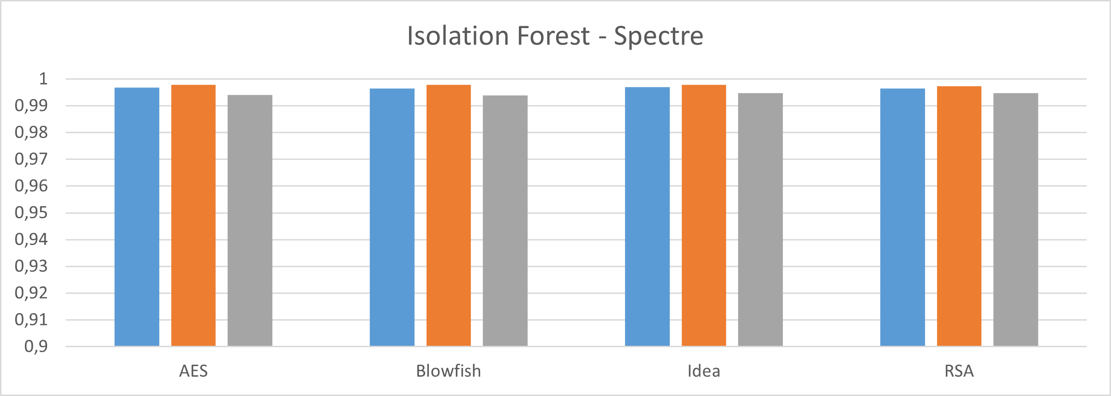
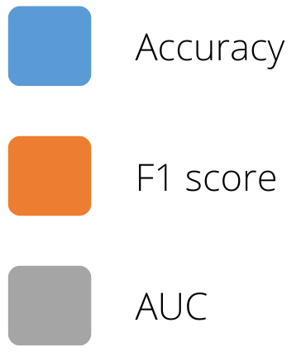
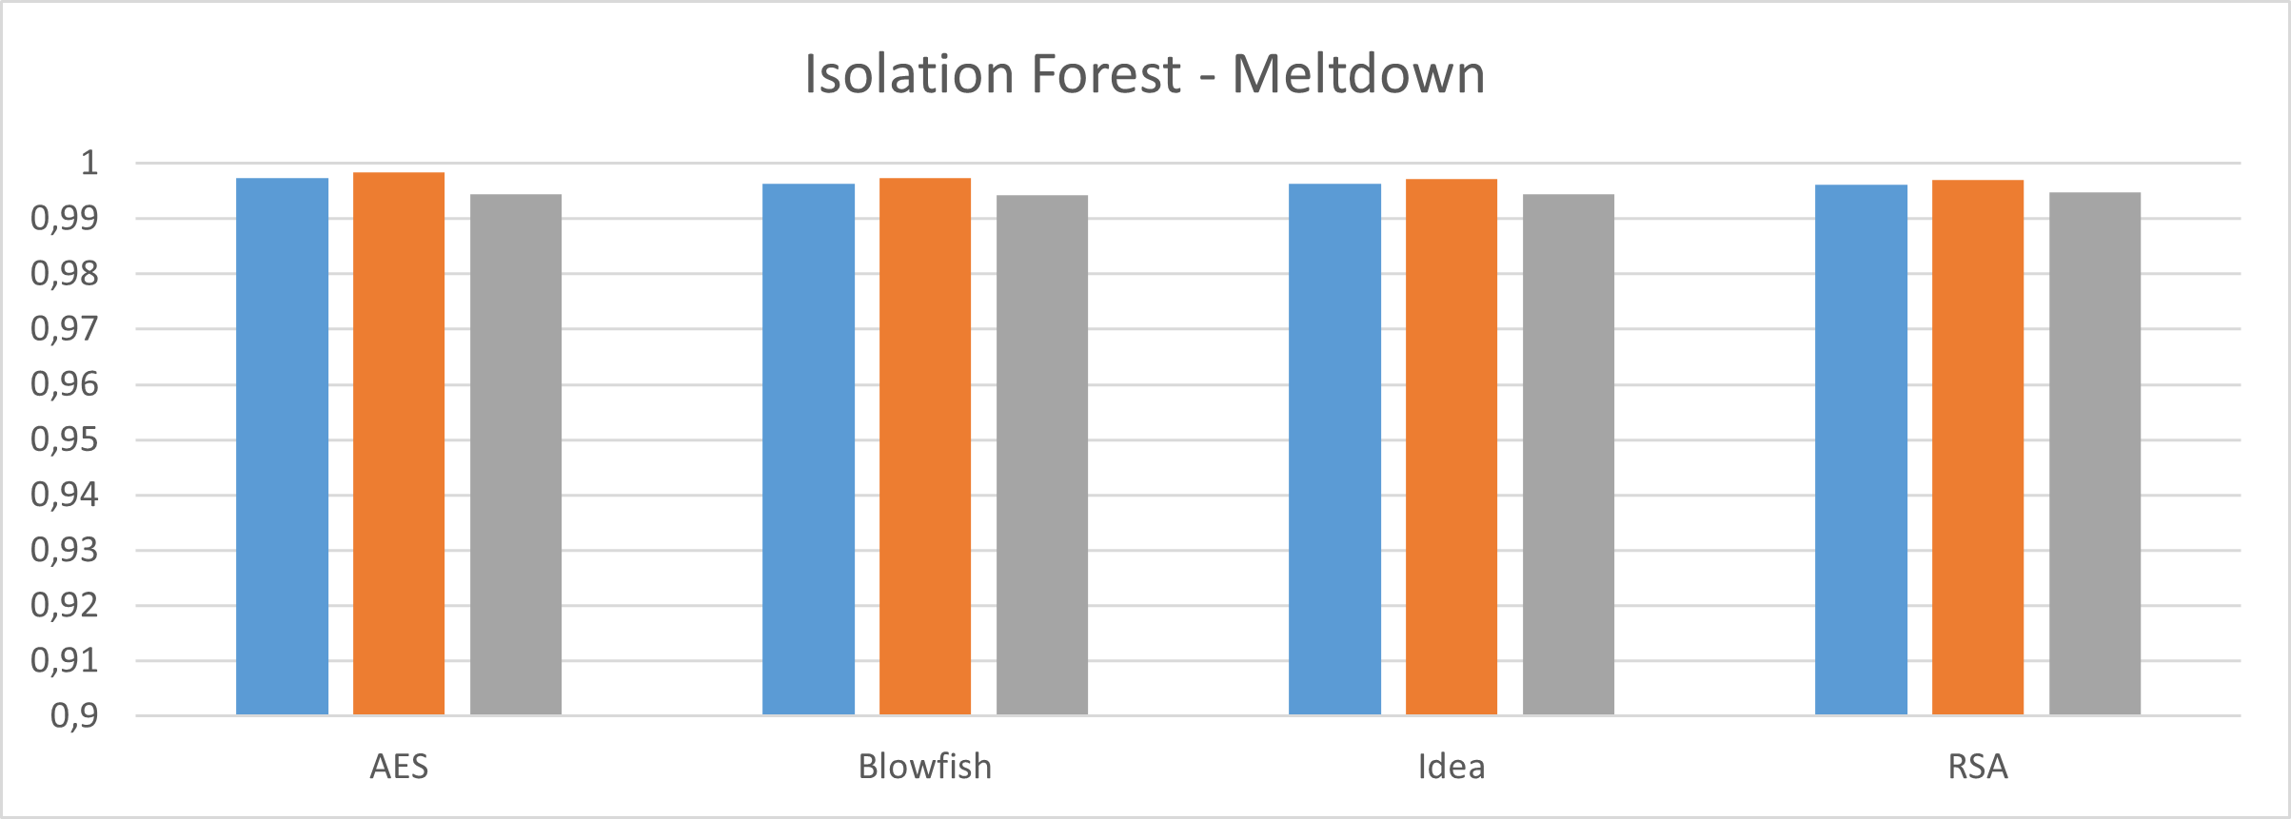
MSCAs: Countermeasures @ POLIMI

Slide 77
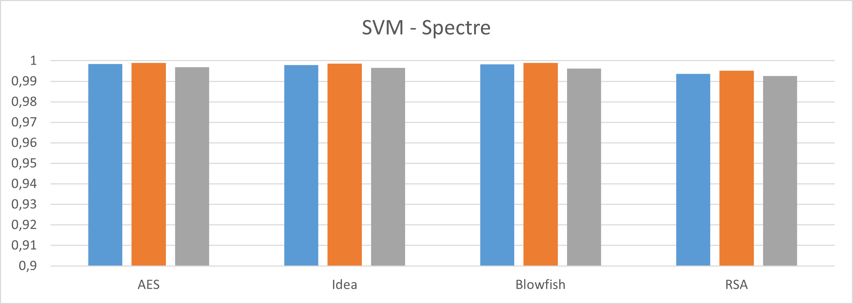
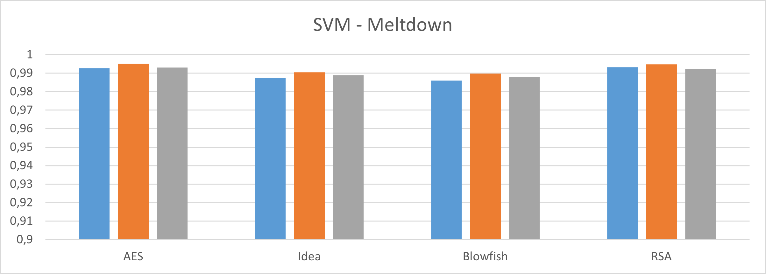
MSCAs: Countermeasures @ POLIMI

Slide 78
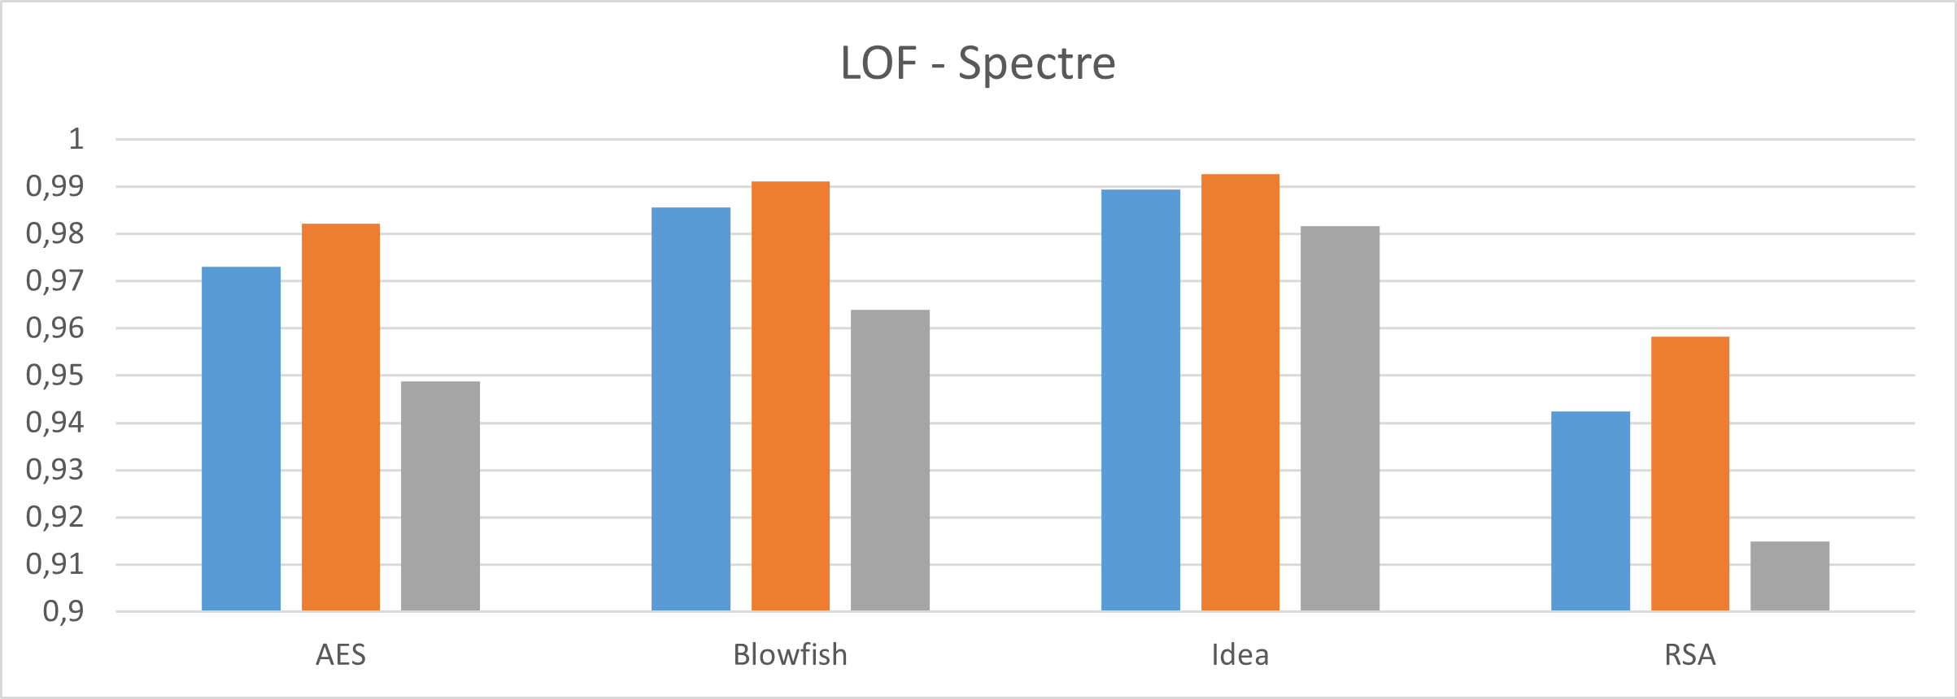
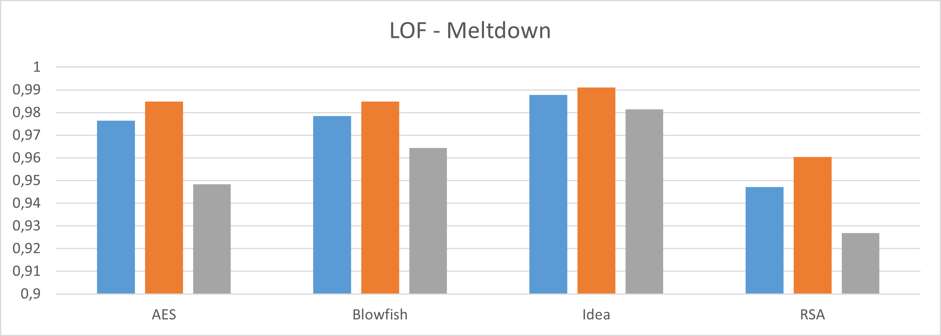
MSCAs: Countermeasures @ POLIMI

Slide 79
MSCAs: Countermeasures @ POLIMI
Isolation Forest
Attacco | Dataset | TP % | TN % | FP % | FN %
Spectre | AES | 63,35% | 35,94% | 0,71% | 0%
 | Blowfish | 70,97% | 28,82% | 0,21% | 0%
 | Idea | 70,8% | 28,63% | 0,57% | 0%
 | RSA | 65,94% | 33,7% | 0,36% | 0%
Meltdown | AES | 67,5% | 31,94% | 0,56% | 0%
 | Blowfish | 69,69% | 30,01% | 0,30% | 0%
 | Idea | 67,09% | 32,6% | 0,31% | 0%
 | RSA | 63,67% | 36,25% | 0,21% | 0%

Slide 80
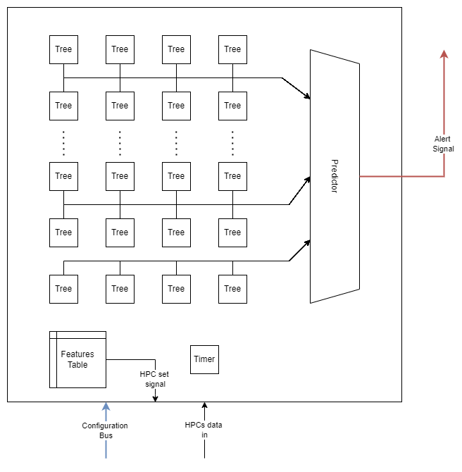
MSCAs: Countermeasures @ POLIMI
Look Up Tables overhead:
Intel Atom*: 25,75%
Intel Nehalem*: 6,7%
* Data taken from the doctorate thesis of Wong: «A Superscalar Out-of-Order x86 Soft Processor for FPGA»
* without L2 cache

Slide 81
Students assignments
S. Crane, A. Homescu, S. Brunthaler, P. Larsen, and M. Franz, “Thwarting cache side-channel attacks through dynamic software diversity,” in Proc. NDSS, 2015, pp. 8–11
S. Rokicki, "GhostBusters: Mitigating Spectre Attacks on a DBT-Based Processor," 2020 Design, Automation & Test in Europe Conference & Exhibition (DATE), Grenoble, France, 2020, pp. 927-932
Akyildiz, Taha Atahan, et al. "MeltdownDetector: A runtime approach for detecting meltdown attacks." Future Generation Computer Systems 112 (2020): 136-147
H. Wang, H. Sayadi, G. Kolhe, A. Sasan, S. Rafatirad and H. Homayoun, "Phased-Guard: Multi-Phase Machine Learning Framework for Detection and Identification of Zero-Day Microarchitectural Side-Channel Attacks," 2020 IEEE 38th International Conference on Computer Design (ICCD), Hartford, CT, USA, 2020, pp. 648-655
H. Wang, H. Sayadi, S. Rafatirad, A. Sasan and H. Homayoun, "SCARF: Detecting Side-Channel Attacks at Real-time using Low-level Hardware Features," 2020 IEEE 26th International Symposium on On-Line Testing and Robust System Design (IOLTS), Napoli, Italy, 2020, pp. 1-6

Slide 82
References
Wenjie Xiong and Jakub Szefer. 2021. “Survey of Transient Execution Attacks and Their Mitigations”. ACM Comput. Surv. 54, 3, Article 54 (April 2022), 36 pages.
Claudio Canella, Jo Van Bulck, Michael Schwarz, Moritz Lipp, Benjamin Von Berg, Philipp Ortner, Frank Piessens, Dmitry Evtyushkin, and Daniel Gruss. 2019. "A systematic evaluation of transient execution attacks and defenses". In Proceedings of the 28th USENIX Conference on Security Symposium (SEC'19). USENIX Association, USA, 249–266.
Claudio Canella, Khaled N. Khasawneh, and Daniel Gruss. 2020. “The Evolution of Transient-Execution Attacks”. In Proceedings of the 2020 on Great Lakes Symposium on VLSI (GLSVLSI '20). Association for Computing Machinery, New York, NY, USA, 163–168.
M. Schwarz and D. Gruss, "How Trusted Execution Environments Fuel Research on Microarchitectural Attacks," in IEEE Security & Privacy, vol. 18, no. 5, pp. 18-27, Sept.-Oct. 2020
Lipp, Moritz, et al. "Meltdown: Reading kernel memory from user space." Communications of the ACM 63.6 (2020): 46-56.
Kocher, Paul, et al. "Spectre attacks: Exploiting speculative execution." Communications of the ACM 63.7 (2020): 93-101.
Van Bulck, Jo, et al. "Foreshadow: Extracting the keys to the Intel SGX kingdom with transient out-of-order execution." Proceedings fo the 27th USENIX Security Symposium. USENIX Association, 2018.
Schwarz, Michael, et al. "ZombieLoad: Cross-privilege-boundary data sampling." Proceedings of the 2019 ACM SIGSAC Conference on Computer and Communications Security. 2019.
Van Bulck, Jo, et al. "LVI: Hijacking transient execution through microarchitectural load value injection." 2020 IEEE Symposium on Security and Privacy (SP). IEEE, 2020.
https://www.theregister.com/2022/07/12/amd_intel_retbleed/

